Slide 1
PRESENTED BY:
-PRATYUSH KUMAR
-PRADEEP KUMAR

Slide 2

FLAPPY BIRD GAME USING C++

Slide 3
ABOUT THIS GAME
Flappy Bird is an arcade-style game in which the player controls the bird FABY, which moves persistently to the right. The player is tasked with navigating FABY through pairs of pipes that have equally sized gaps placed at random heights. FABY automatically descends and only ascends when the player taps the touchscreen. Each successful pass through a pair of pipes awards the player one point. Colliding with a pipe or the ground ends the gameplay. During the GAME OVER screen, the player is awarded a bronze medal if they reached ten or more points, a silver medal from twenty points, a gold medal from thirty points, and a platinum medal from forty points

Slide 4
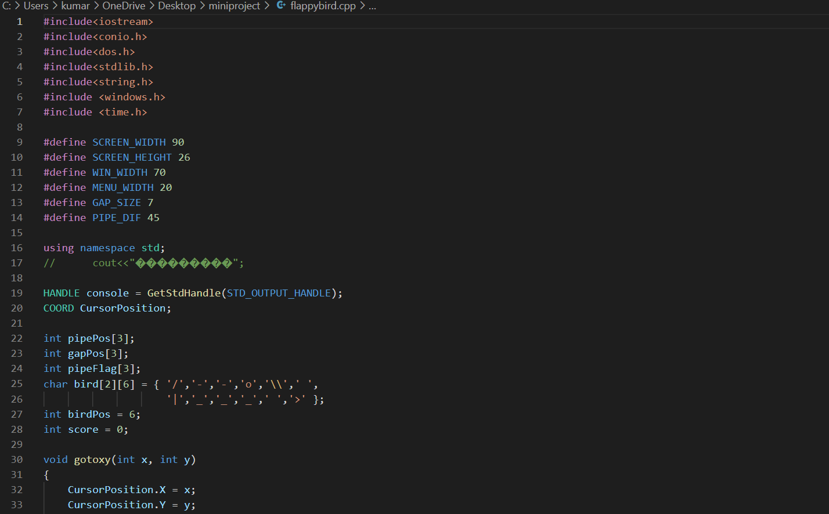
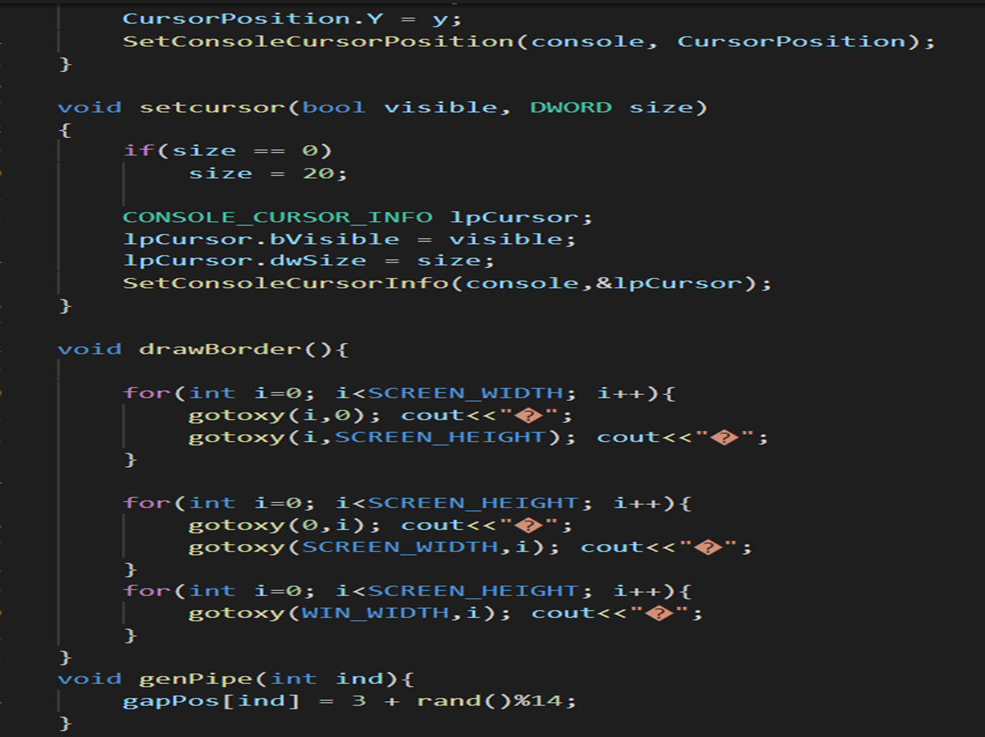
CODE

Slide 5
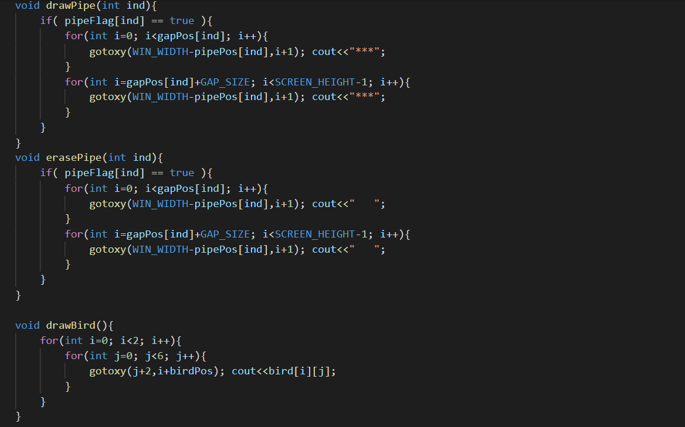
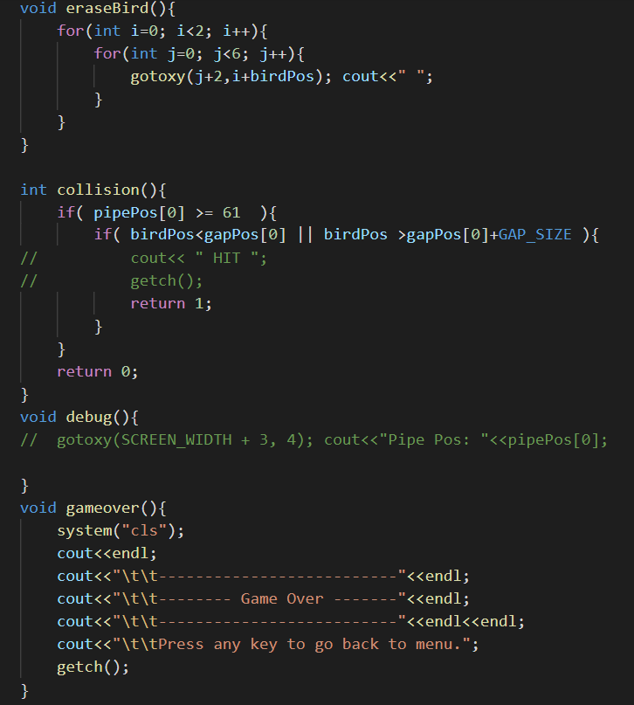

Slide 6
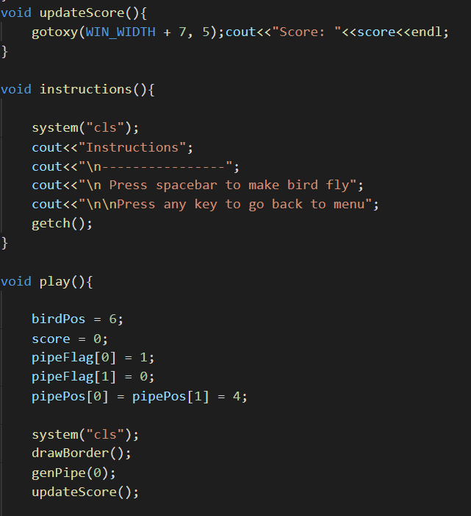
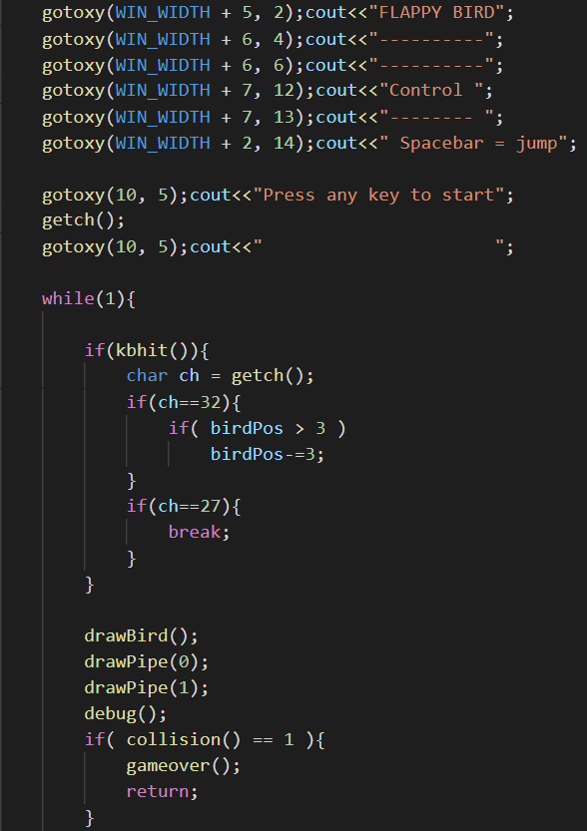

Slide 7
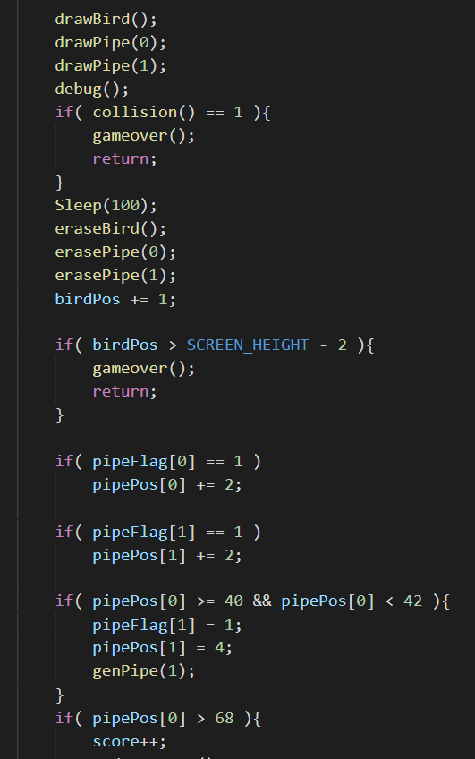
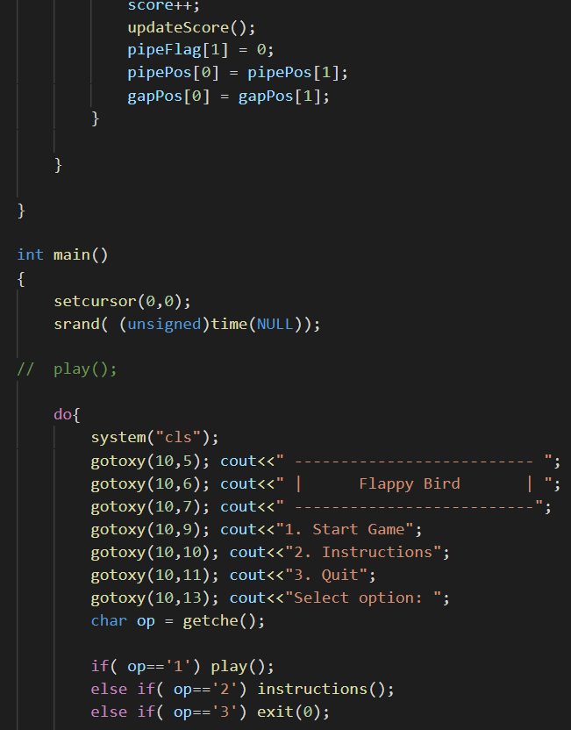

Slide 8
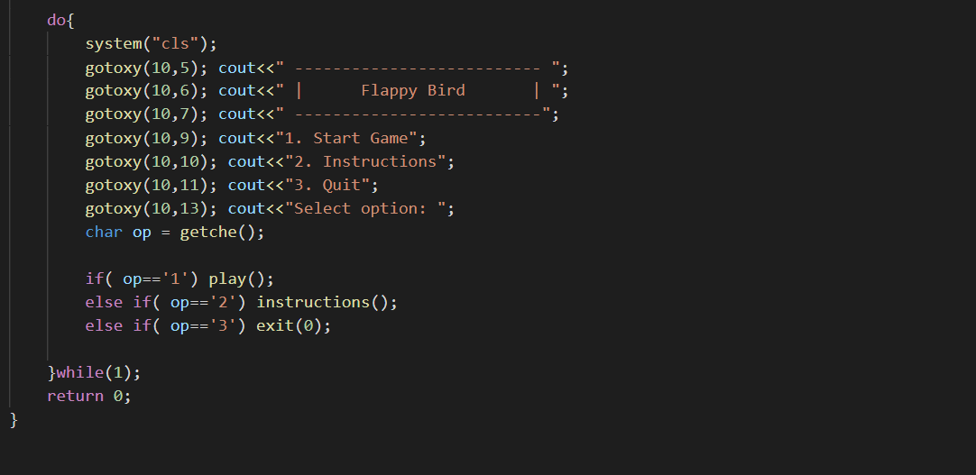

Slide 9
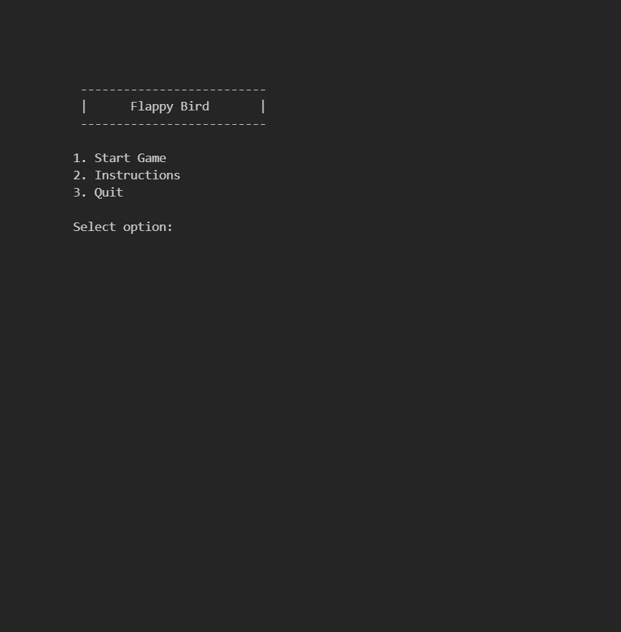
OUTPUT

Slide 10
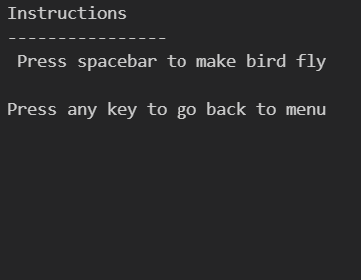

Slide 11
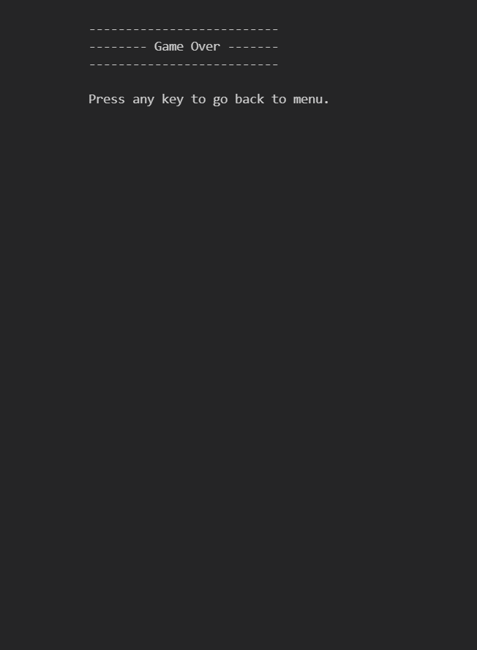

Slide 12
BIBLOGRAOHY:
VISUAL STDIO CODE
GOOGLE.COM
GRAPHICS
C++ LANGUAGE

Slide 13
THANK YOU
******************

